Slide 1
Case 3 Uber Case
Exploring Uber/taxi data
PRESENTED BY Group 5
WPI

Slide 2

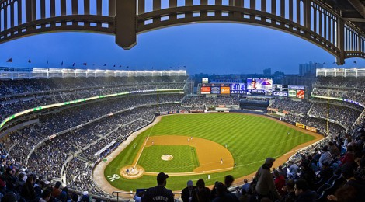

Background & Intro
Sports Stadiums in New York
Plenty Taxi Data
WPI
Notes:
ke

Slide 3
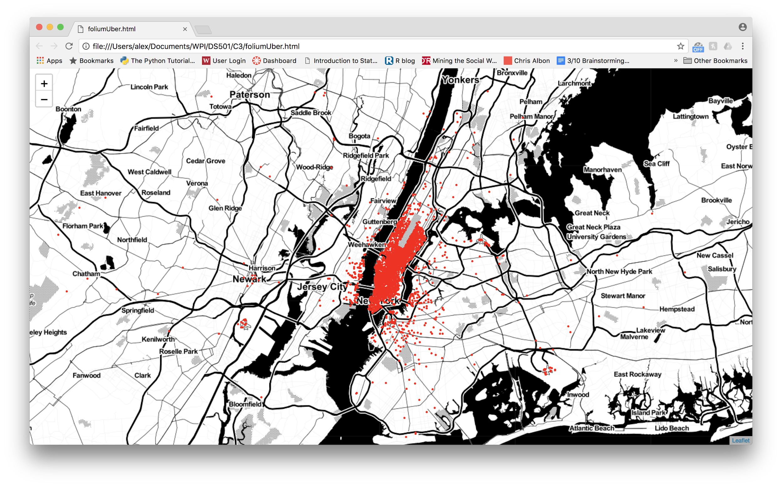
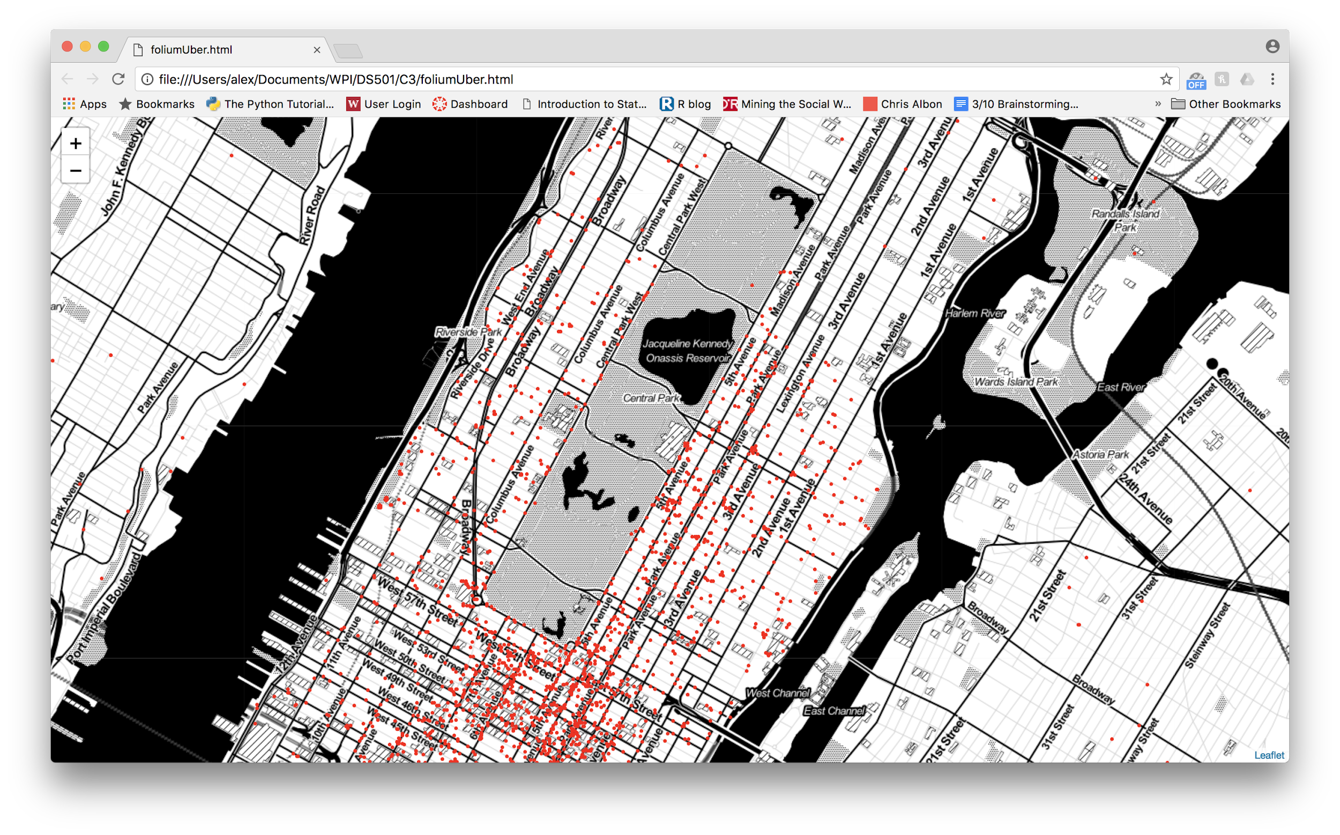
Spatial distribution of 5000 Uber pickups in Apr, 2014
Data source: FiveThirtyEight
WPI
Notes:
ke

Slide 4
Game Day Data Exploration
Where do fans come and go?
Where do fans work and live?
Tipping pattern on different game results?
WPI
Notes:
ke

Slide 5




Methodology
Database Setup
Data Querying
Spatial Plotting
Tip Analysis
WPI
Notes:
“dibs”
-Gunnar-

Slide 6



Database Setup
Data Querying
Spatial Plotting
Tip Analysis
Google Cloud Compute
single instance
16gb ram
300gb disk
300M taxi GPS tuples
2015 only
yellow/green only
PostgreSQL
simple, quick
WPI
Notes:
“dibs”
-Gunnar-

Slide 7
Database Setup
Data Querying
Spatial Plotting
Tip Analysis
Single, obnoxious query (kind-of)
SELECT * FROM rides where
(GPS_LAT between LAT_MIN and LAT_MAX) and
(GPS_LONG between LONG_MIN and LONG_MAX) and
((DROP_TIME between GAME_1_START and GAME_1_END) or
(DROP_TIME between GAME_2_START and GAME_2_END) or
…
(DROP_TIME between GAME_N_START and GAME_N_END))
WPI
Notes:
“dibs”
-Gunnar-

Slide 8
Database Setup
Data Querying
Spatial Plotting
Tip Analysis
Visualize pre-game pickups and post-game dropoffs
Folium library (Python + Leaflet.js)
WPI
Notes:
Yang

Slide 9
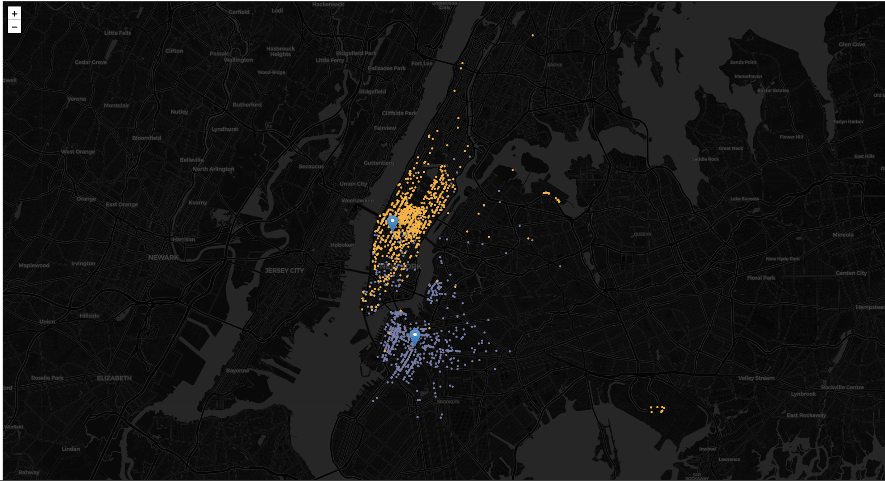
Pre-game spatial plotting of Knicks and Nets fans
WPI
Notes:
Yang

Slide 10
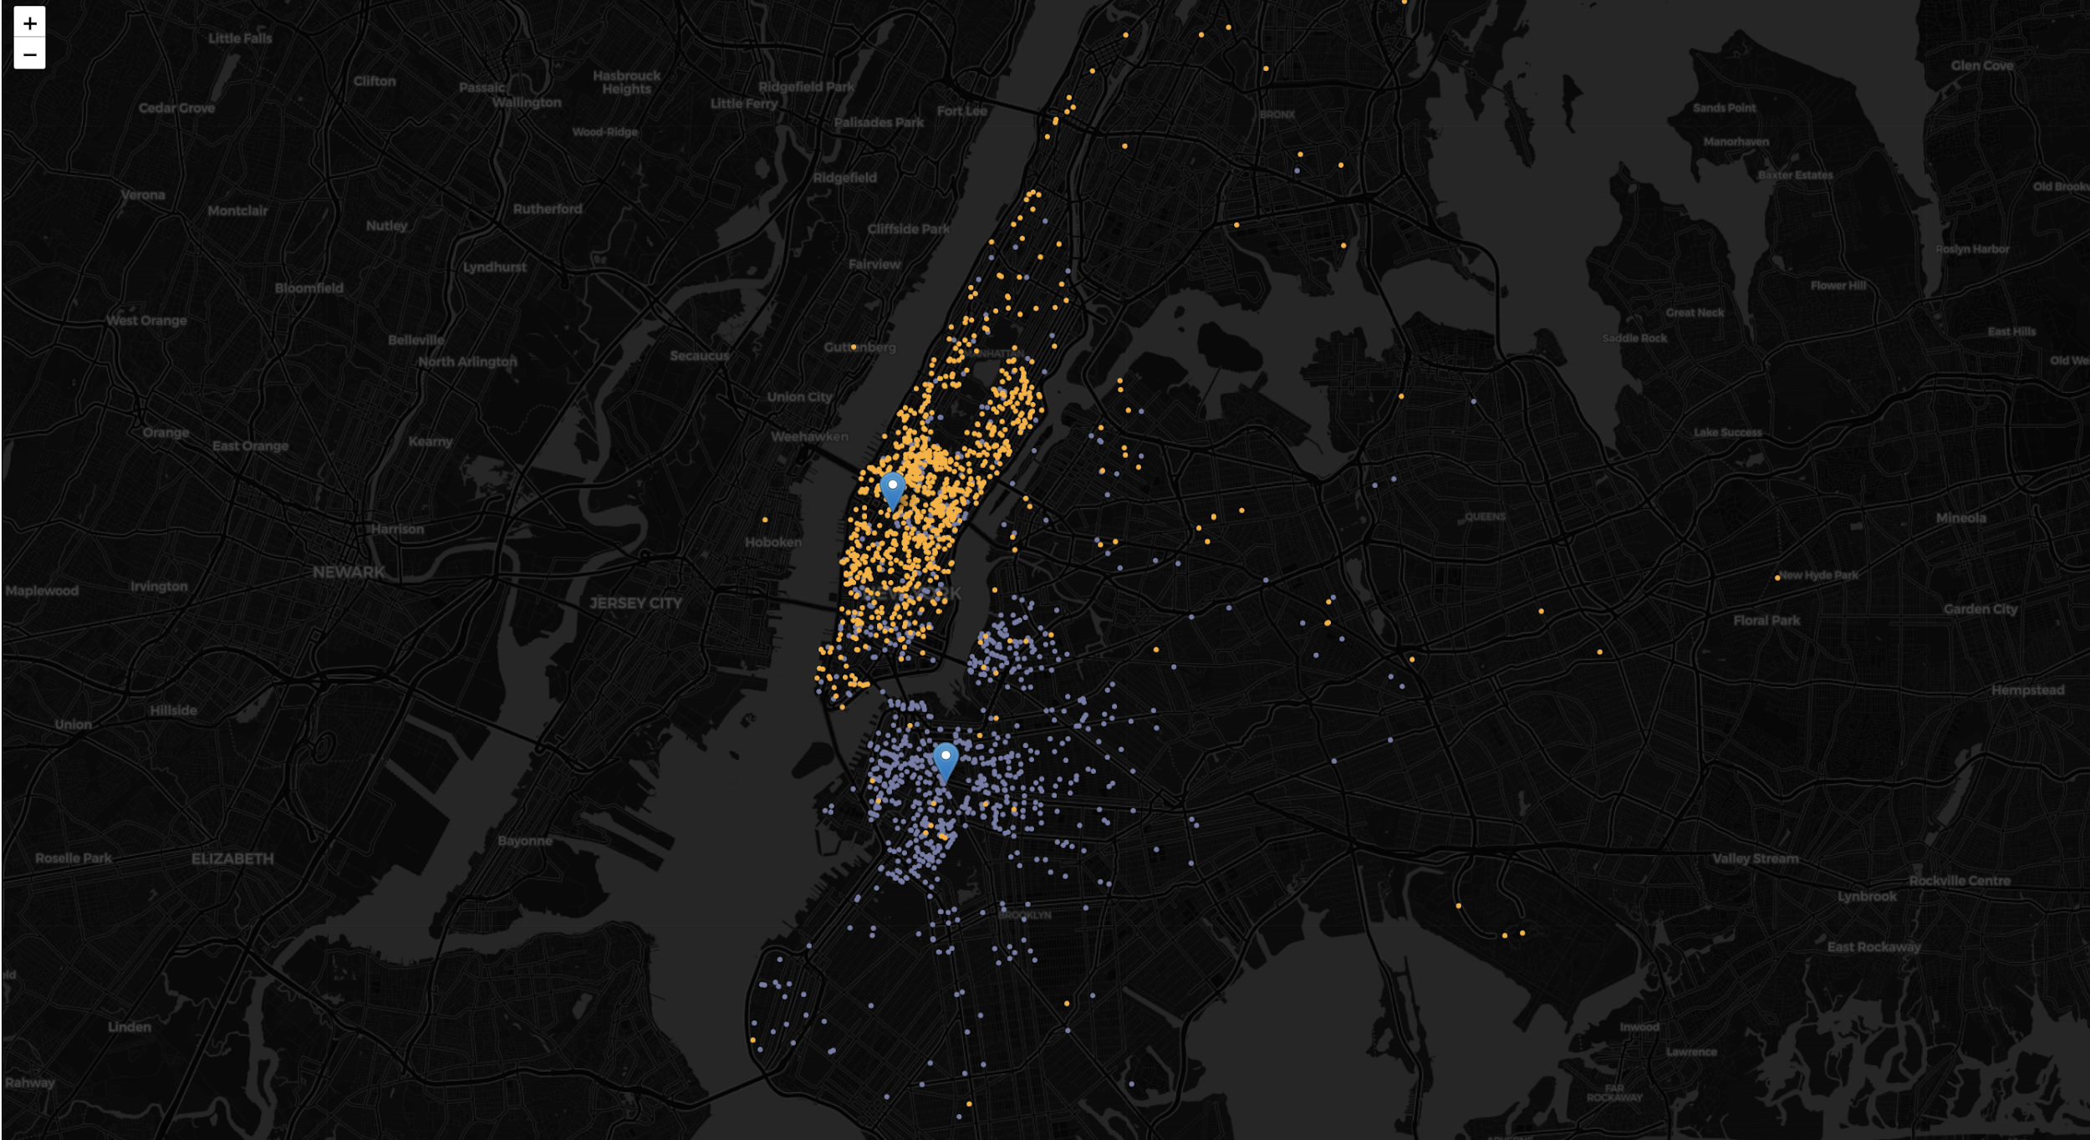
Post-game spatial plotting of Knicks and Nets fans
WPI
Notes:
Yang

Slide 11
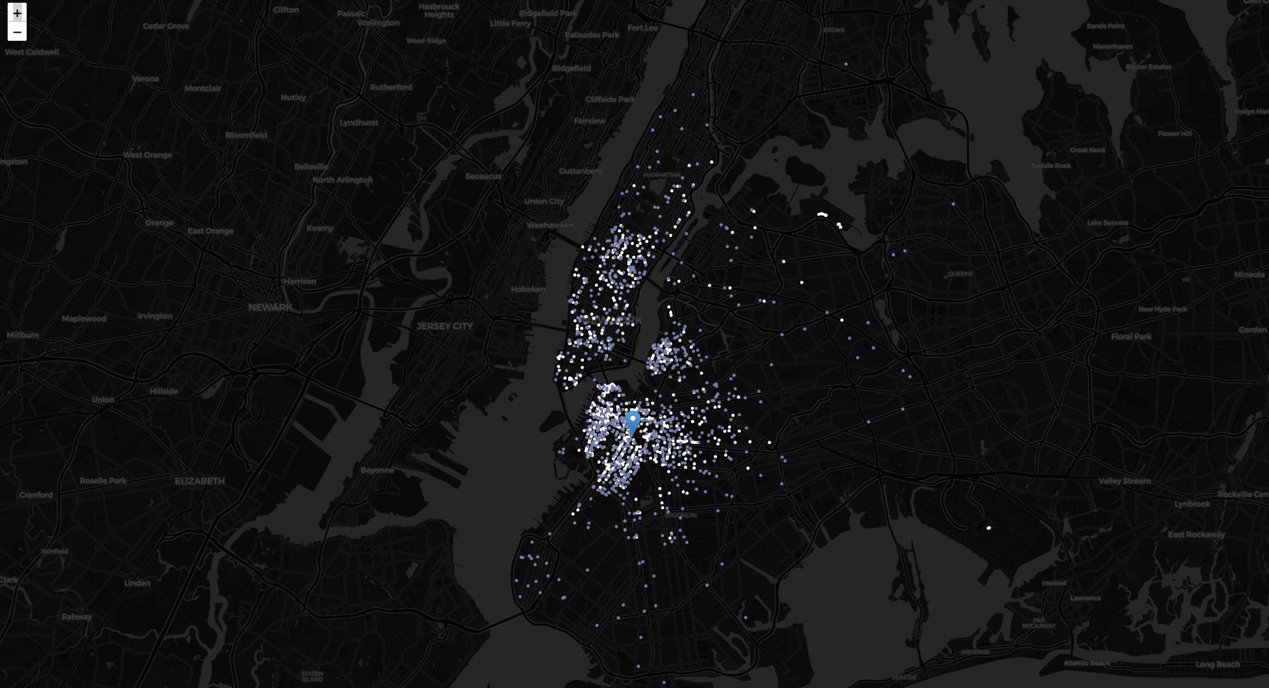
Pre/Post-game comparison on Nets fans
WPI
Notes:
Yang

Slide 12
Database Setup
Data Querying
Spatial Plotting
Tip Analysis
Tip Ratio
defined as: tip_amount / total_amount (other than tips)
Focusing on trips with card payment
cash: 0 tips
Capture the game result
(Win or Lose)
Plot Bar Chart to compare the result
WPI

Slide 13
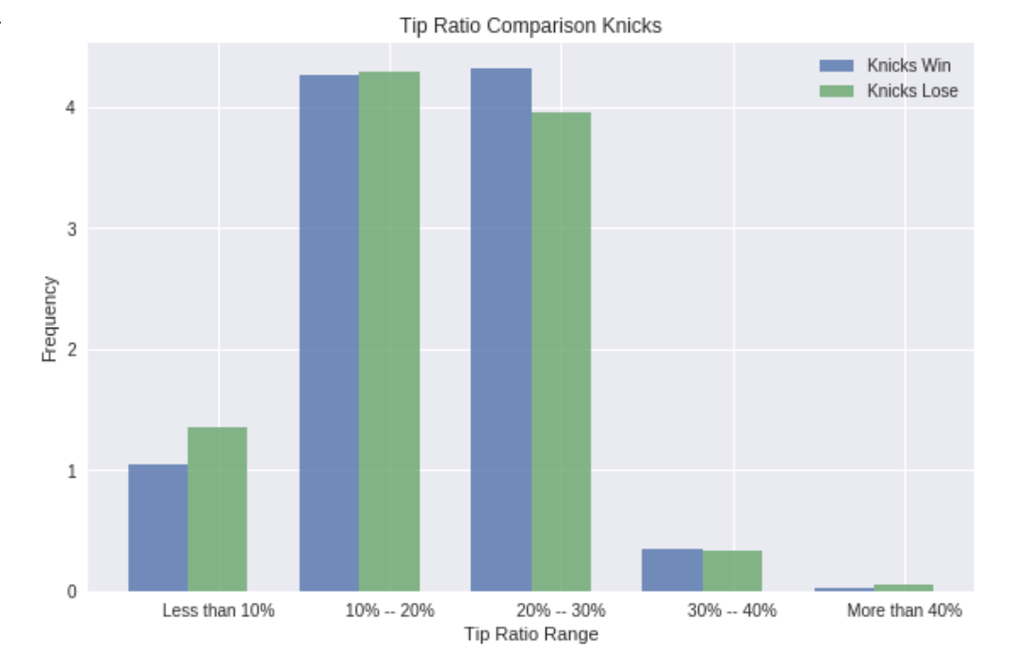
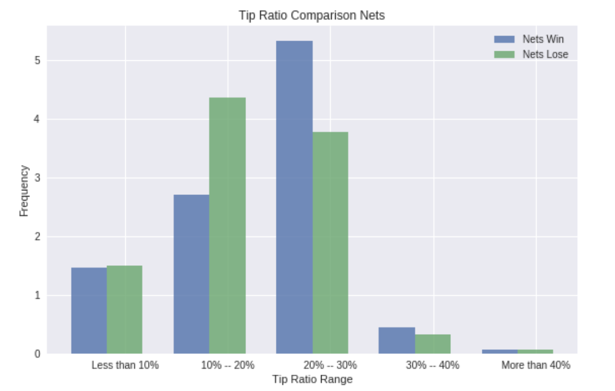
Tip Analysis
WPI

Slide 14
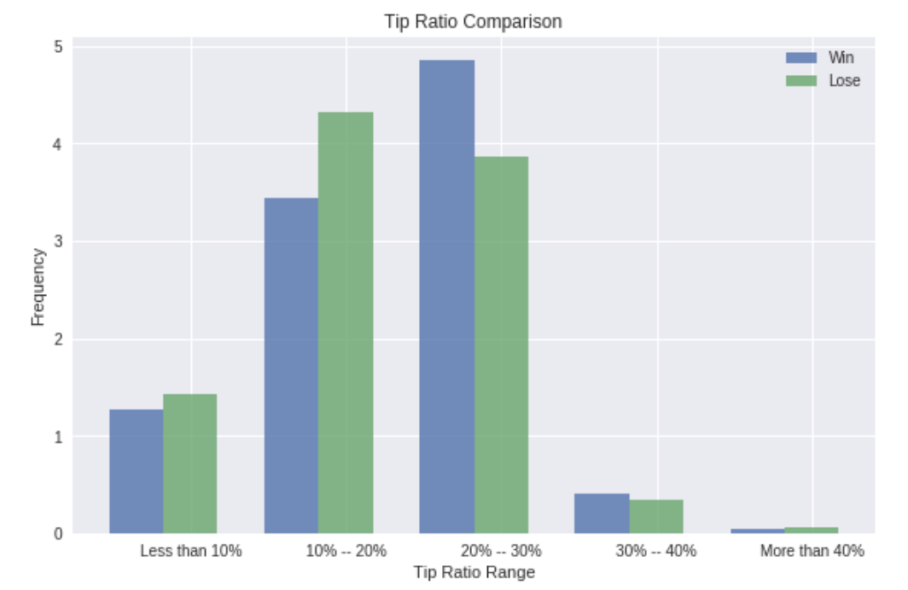
Tip Analysis
WPI

Slide 15
Conclusions
Billions of NYC Taxi/Uber data enable data exploration in all aspects
Spatial plotting of pre-game GPS_pickups and post-game GPS_dropoffs enable visualization of fans habitants/advertising targets
New Yorkers tend to tip more when their home team win
WPI

Slide 16
THANKS
WPI

